Slide 1

San Diego Hearts
Healthy hearts for all

Slide 2
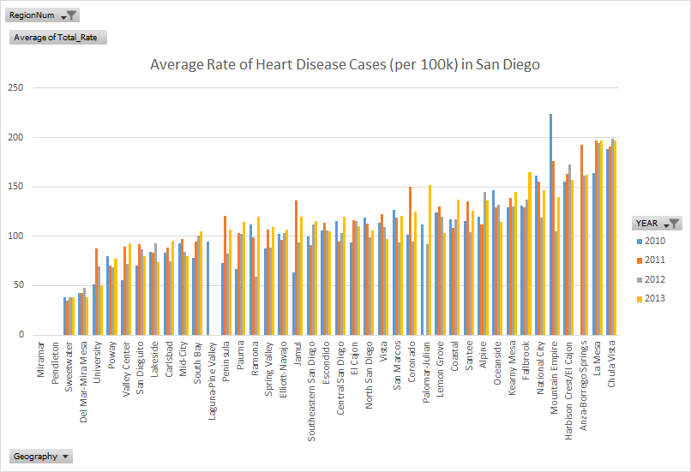
Heart Disease is among the top 5 killers of San Diegans.
https://data.livewellsd.org
Notes:
Top 5 killers: Cancer, Heart disease, Alzheimer’s disease, respiratory diseases, cerebrovascular diseases.
San Diego County information

Slide 3



Lifestyle and Environment
Demographics
Nutrition
Attributes: age, sex, income, ethnicity, physical location
Data extracted from: https://data.livewellsd.org
Attributes: consumer expenditure analysis of tobacco, alcohol, healthy (fruits, vegetables), unhealthy (fast food)
Data collected from: Bureau of the Census: Consumer Expenditure Survey
Attributes: accessibility to parks, fast food, grocery stores, fitness, hospital
Data scraped from: https://www.yelp.com/san-diego

Slide 4



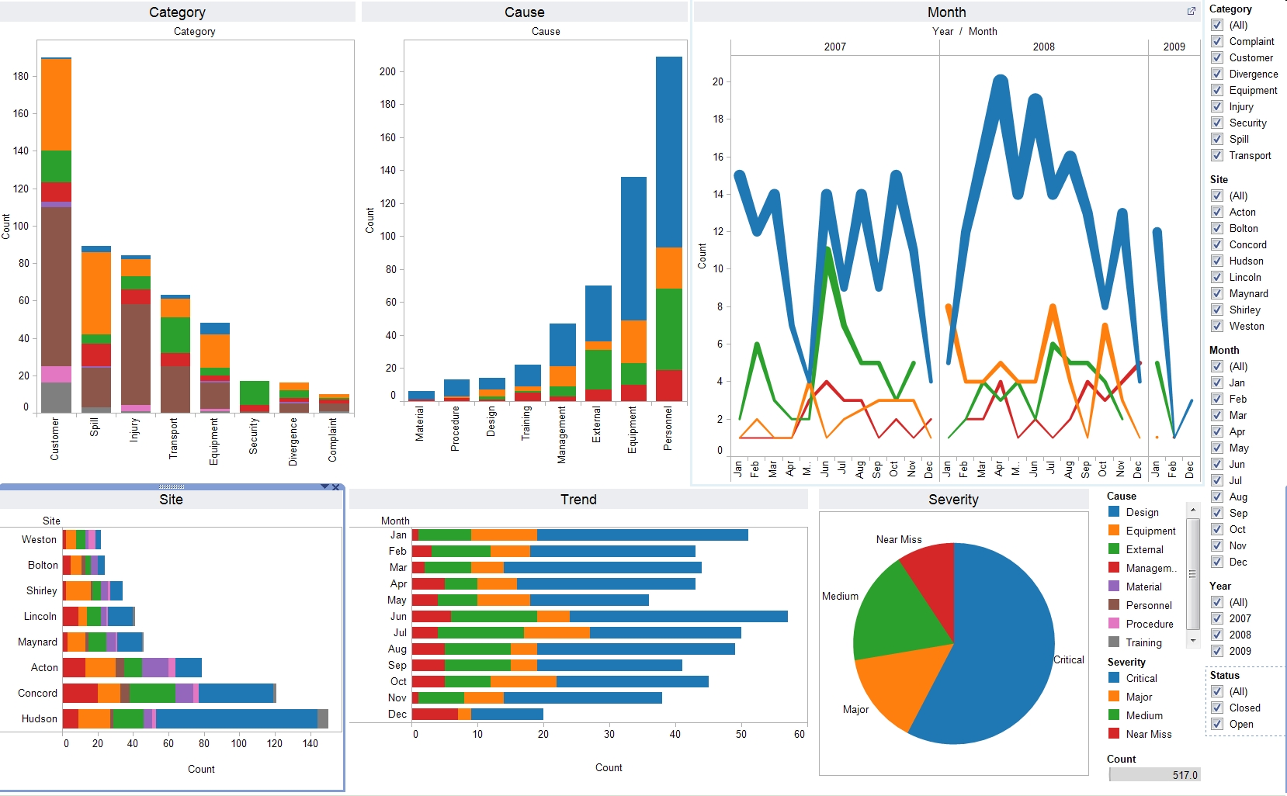







Workflow
Potential Datasets
Tools
Product

Slide 5

Goal:
Aim: Examine the factors contributing to varying heart disease rates across San Diego and possible recommendations.
Product: Dashboards which allows the general public and public health department to see which San Diego regions are at higher risks of heart disease.
Possibly analyzing efforts by HHSA (Public Health Department) in spreading awareness

Slide 6




Meet the Team: DataPros
Disha Singla
UCSD
Ehab Abdelmaguid
UCSD
Michael Galarnyk
UCSD
Orysya Stus
UCSD
Akshit Bhatnagar
UCSD

